Slide 1
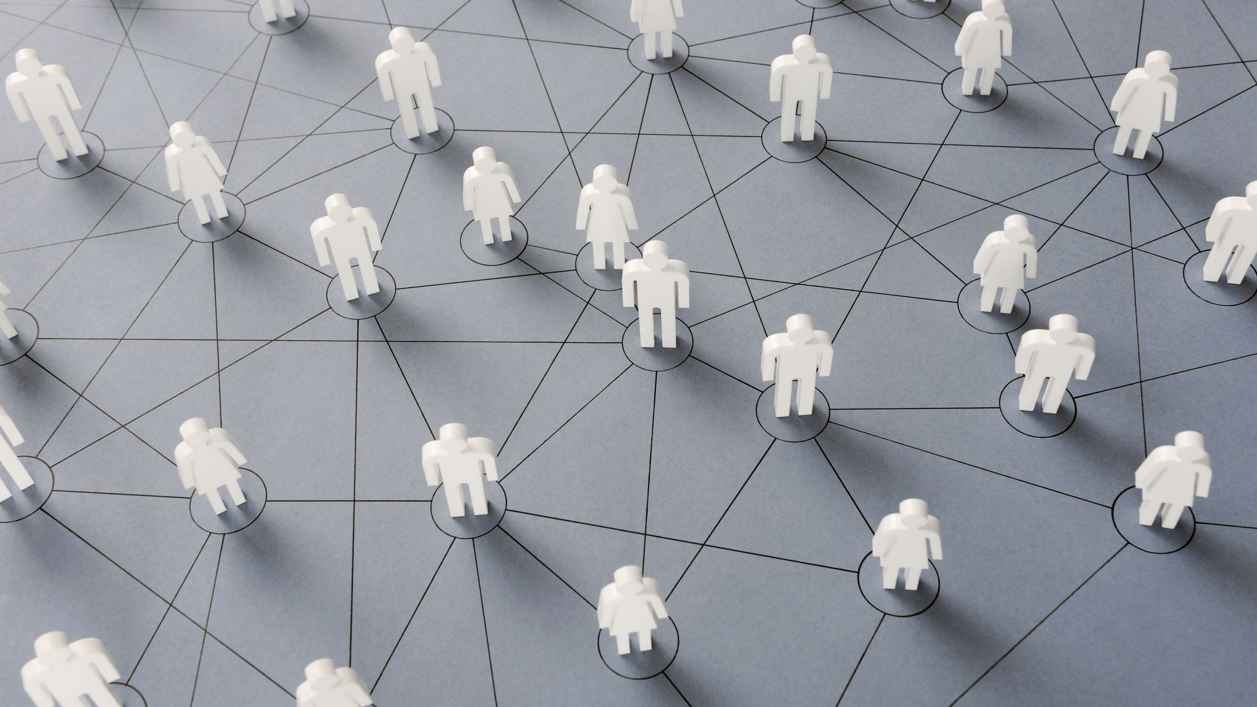
Social Connectedness and Relationship Satisfaction in the Digital Age
By Andrea Rodriguez-Arzola and Hunter Tholkes

Slide 2
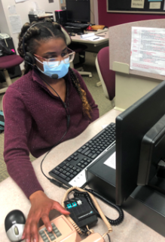
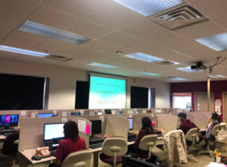
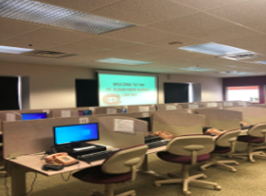
About the Stephen Frank SCSU Survey Center
Founded in 1980
Located on campus in Stewart Hall
Partnership between undergraduate students and faculty
Strives to assure all students and faculty contribute to the research process

Slide 3
Methods
Survey data was collected via telephone and Qualtrics.
SCSU survey conducted a telephone survey from 2/12/22 through 2/28/22 on weekdays during evening hours, except for Fridays and on Saturday in the afternoon and on Sunday during evening hours.
This study was approved by the SCSU IRB, and callers were trained in ethical data collection.
The survey employs a Computer Assisted Telephone Interviewing (CATI) program called WinCati and the analysis was done using SPSS
A representative sample of St. Cloud State University students ages 18 and older who provided their phone number were interviewed by landline and cell phone.
A total of 682 respondents completed the survey, 352 via telephone and 330 via Qualtrics.
Interviewers asked questions about various issues on and off campus, as well as demographic questions.

Slide 4
Independent Variables Used
Relationship Status
Social Media Comparison
Relationship Satisfaction
Religious Service Attendance

Slide 5
Hypothesis for Relationship Status
When comparing single and married or in a committed relationship students, we anticipate that single students are more likely to feel worse about their own relationship status based on the posts they see on social media.
According to a study done by PEW Research Center, of single social media users, 33% feel that seeing social media posts make them feel worse about their own relationship status.
Vogels, E., & Anderson, M. (2020, May 8). Dating and relationships in the digital age. Pew Research Center Science & Society.

Slide 6
Feelings towards relationship status with social media
%
In general, the posts you see about other people’s relationships make you feel...
Better about your own relationship status
Worse about your own relationship status
Doesn't make much difference
%
%

Slide 7
Relationship Status Results
%
%
%
%
%
%

Slide 8
Hypothesis for Relationship Satisfaction and Social Media Comparison
When looking at relationship satisfaction, we anticipate that those who are not satisfied are more likely to have a worse view on their relationship status based on social media use when comparing those who are satisfied.
Research has shown that, "Facebook use can reduce relationship satisfaction by providing potential romantic alternatives and deflecting time and emotional investments away from the committed relationship" (Abbadi & Alghamdi).
Abbasi, I. S., & Alghamdi, N. G. (2018). The pursuit of romantic alternatives online: Social media friends as potential alternatives. Journal of Sex & Marital Therapy, 44(1), 16–28. https://doi-org/10.1080/0092623X.2017.1308450

Slide 9
Relationship Satisfaction
How happy are you with your social relationships?
Satisfied
Somewhat Satisfied
Not Satisfied
%
%
%

Slide 10
Relationship Satisfaction Results
%
%
%
%
%
%

Slide 11
Hypothesis for Social Isolation and Social Media Comparison
Those who are at risk for social isolation are more susceptible to social media comparison – either positively or negatively.
According to Primack et al. (2019), it was found that participants who compare their relationships through social media were more likely to have negative feelings and experiences that led to higher rates of social isolation scores.
Primack, B. A., Karim, S. A., Shensa, A., Bowman, N., Knight, J., & Sidani, J. E. (2019). Positive and negative experiences on social media and perceived social isolation. American Journal of Health Promotion, 33(6), 859–868. https://doi.org/10.1177/0890117118824196
Notes:
Although the initial conception of the social media comparison question was to illicit participants’ social media use and how it may have caused participants to check how often they saw posts on social media about its effect on their reflection of their relationship status; after Andrea proposed the question for the survey, based on past literature referencing individuals who are at risk for social isolation being more prone to relationship comparison due to their lack of relationships, I thought it would fit well with either a positive or negative view of their relationships.

Slide 12
Social Isolation
%
%
How many friends and relatives do you feel close to such that you can call on them for help?
Zero
One
Two
Three to Four
Five to Eight
Nine or more
%
Notes:
Note: "At-Risk" can be defined as a person having ≤2 people they feel they can call on for help.
We collapsed responses to fit "At-Risk" and "Not At-Risk"

Slide 13
Social Media Results
%
%
%
%
%
%
Notes:
Those who were at risk for social isolation were more likely to have positive or negative feelings about their relationship status due to social media comparison. They were twice as likely to “judge” their relationship status. This is due to individuals who are at risk, being more likely to be less satisfied (84% of those who were at risk were not satisfied to somewhat satisfied with their social relationships compared to only 32% for those who were not at risk).
For those who were not at risk, were less likely to have positive or negative feelings towards their own relationship status. They were less likely to be affected by seeing posts about other people on social media.
This is due to a not at-risk participants score of relationship satisfaction.

Slide 14
Hypothesis for Social Isolation and Relationship Status
When comparing relationship status and social isolation, single students are more likely than married/in a committed relationship students to be at-risk for social isolation.
According to Primack et al. (2019) and Hawthorne (2008), it was shown that single participants were more likely to have at-risk social isolation scores compared to participants that were in married/committed relationships.
Primack, B. A., Karim, S. A., Shensa, A., Bowman, N., Knight, J., & Sidani, J. E. (2019). Positive and negative experiences on social media and perceived social isolation. American Journal of Health Promotion, 33(6), 859–868. https://doi.org/10.1177/0890117118824196
Hawthorne, G. (2008). Perceived social isolation in a community sample: Its prevalence and correlates with aspects of peoples’ lives. Social Psychiatry & Psychiatric Epidemiology, 43(2), 140–150. https://doi.org/10.1007/s00127-007-0279-8

Slide 15
Relationship Status Results
%
%
%
%
Notes:
For those who were At-Risk for social isolation, they were far more likely to be single than in a relationship

Slide 16
Hypothesis for Social Isolation and Religious Attendance
We were predicting there to be a relationship between the number of religious services attended and social isolation scores.
The more often, on average, an individual attended a religious service, the lower their likelihood of an “at-risk” social isolation.
Rote et al. (2013) concluded that religious affiliation was associated with a sense of belonging. A sense of community engagement and reciprocity were predictive factors in later social isolation scores. Rosemarin et al. (2009) showed that religious affiliation decreased negative emotions.
Rote, S., Hill, T. D., & Ellison, C. G. (2013). Religious attendance and loneliness in later life. The Gerontologist, 53(1), 39–50. https://doi.org/10.1093/geront/gns063
Rosmarin, D. H., Pargament, K. I., and Mahoney, A. (2009). The Role of Religiousness in Anxiety, Depression, and Happiness in a Jewish Community Sample: A Preliminary Investigation. Mental Health, Religion & Culture 12(2): 97–113. doi:10.1080/13674670802321933.

Slide 17
Religious Service Attendance
In the last twelve months, not including weddings and funerals, how often did you attend religious services?
Never
Once
A few times
2-4 times
About once a month on average
Twice a month
About once a week on average
More than once a week
%
%
%
Notes:
*We collapsed the data
Never=None
1-4 times= Not often
Once a month or more= More often

Slide 18
Religious Attendance Results
%
%
%
%
%
%
Notes:
Although we did not find any statistically significant results, there were slight increasing differences between how often participants went to a religious service and their likelihood of an at-risk social isolation score.

Slide 19
Conclusion
Hypothesis #1: Most people agree that social media doesn't make much difference on how they view their relationship status.
Hypothesis somewhat supported
Hypothesis #2: Most students agree that social media doesn't make much difference on how they view their relationship status, but of those who say it feels makes them feel worse, there are more students who are not satisfied with their relationship
Hypothesis supported
Notes:
Add more religiosity items to further address participants’ “religiousness”.
Figure out a way to gauge personality differences between those that use social media and those that don’t.
Add more items about participants' social media use (e.g., how many apps, what apps most often, how many hours per day do they spend on the apps, etc.)
The relationship comparison item response should not have been so black and white.

Slide 20
Conclusion Continued
Hypothesis #3: More at-risk students responded that social media makes them feel better/worse about their own relationship students, but a majority responded that it doesn't make much difference.
Hypothesis supported
Hypothesis #4: Single students are more likely to be at-risk for social isolation than students who are married/in a committed relationship.
Hypothesis supported
Hypothesis #5: The likelihood to be at-risk or not at-risk for social isolation stays the same no matter how often a student attends religious services.
Hypothesis not supported
Notes:
Add more religiosity items to further address participants’ “religiousness”.
Figure out a way to gauge personality differences between those that use social media and those that don’t.
Add more items about participants' social media use (e.g., how many apps, what apps most often, how many hours per day do they spend on the apps, etc.)
The relationship comparison item response should not have been so black and white.

Slide 21
Reflections
How our topics influenced the survey design
Why this is important
What we would change

