Slide 1
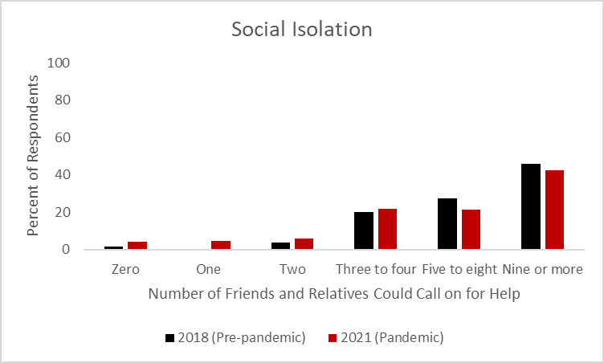
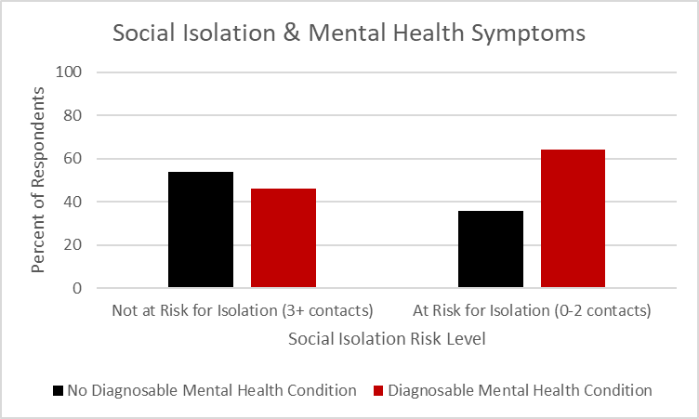
Social isolation, religious affiliation, and mental health in adult Minnesotans
Hunter G. Tholkes & Amanda Hemmesch, Ph.D., Department of Psychology
James Cottrill, Ph.D., Department of Political Science
Ann Finan, Ph.D., & Sandrine Zerbib, Ph.D., Department of Sociology
St. Cloud State University, St. Cloud, MN
Introduction
Results
Results (cont.)
Background
• Social isolation involves an individuals’ social network (i.e., quantity, quality, and structure) and their appraisal of relationships (Wang et al., 2017).
• Social isolation has been associated with an increase in mortality (Pantell et al., 2013) and a vulnerability for various mental-health issues (e.g., depression, anxiety, PTSD, etc.; Achterbergh et al., 2020; Ma et al., 2020).
• Religious affiliation often involves greater social involvement, while simultaneously being associated with an increase in a sense of belonging (Rote, Hill, & Ellison, 2013), and a decrease in negative emotions (Rosemarin, Pargament, & Mahoney, 2009).
Hypotheses
• We predicted that participants would be at a higher risk for social isolation during the COVID-19 pandemic than was observed in a previous survey before the pandemic.
• We predicted that participants who were at risk for social isolation would self-report more diagnosable mental health conditions.
• We predicted that participants who were affiliated with a religion would be at lower risk for social isolation.
Descriptive Statistics
• Approximately 14% of participants were at risk for social isolation (they had two or fewer people they could call on for help).
• Approximately 49% of participants indicated they had or ever had a diagnosable mental health condition.
• Approximately 75% of participants indicated a religious affiliation, with the most common denominations being Roman Catholic (24%) Mainline Protestant (24%), Evangelical Protestant (14%), or some other religion (14%).
Hypothesis Testing
• As predicted, there was a significant difference in risk for social isolation before and during the COVID-19 pandemic, chi-square = 6.23, p = .01, such that a higher percentage of participants were at risk for isolation during the pandemic (14%) than before the pandemic (9%).
• As predicted, there was a significant relationship between social isolation and mental health, chi-square = 4.33, p = .04, such that participants who were at risk for social isolation were more likely to self-report a diagnosable mental health condition.
• There was not a significant relationship between social isolation and religious affiliation, chi-square = .18, p = .67.
Conclusions
Implications
• Findings illustrate a potential increase in social isolation during the COVID-19 pandemic.
• These results highlight how important social connections are to personal well-being and perceptions of mental health. Interventions that foster social connection may be especially important during the pandemic.
• Religious affiliation was not associated with risk for social isolation.
Future Directions
• Our religion item was limited; we asked participants about religious affiliation. We plan to add another item to our next survey to address religious participation.
Methods
Participants
• A random sample of 277 adults living in Minnesota (51% women; 75% white; age M = 48.39, SD = 17.90 years)
• 6% response rate
• 80% cooperation rate
• 6.1% margin of error (at 95% confidence level)
Method
• A list of telephone numbers with Minnesota area codes was generated via random digit dialing (Dynata, Inc)
• Data was collected October 11-30, 2021
• Participants completed a telephone survey about political and social issues that lasted approximately 15 minutes
• Student callers were trained to minimize bias during interviews
Data Preparation and Analysis
• Data was weighted on age to better match the adult population of Minnesota
• Frequencies and chi-square analyses were used to analyze data
References
Achterbergh, L., Pitman, A., Birken, M., Pearce, E., Sno, H., & Johnson, S. (2020). The experience of loneliness among young people with depression: a qualitative meta-synthesis of the literature. BMC Psychiatry, 20(1), 415. https://doi.org/10.1186/s12888-020-02818-3
Ma, R., Mann, F., Wang, J., Lloyd-Evans, B., Terhune, J., Al-Shihabi, A., & Johnson, S.. (2020). The effectiveness of interventions for reducing subjective and objective social isolation among people with mental health problems: A systematic review. Social Psychiatry and Psychiatric Epidemiology, 55(7), 839-876. https://doi.org/10.1007/s00127-019-01800-z
Pantell, M., Rehkopf, D., Jutte, D., Syme, S. L., Balmes, J., & Adler, N. (2013). Social isolation:
a predictor of mortality comparable to traditional clinical risk factors. American Journal of Public Health, 103(11), 2056-62. https://doi.org/10.2105/AJPH.2013.301261
Rosmarin, D. H., Pargament, K. I., and Mahoney, A. (2009). The role of religiousness in anxiety, depression, and happiness in a Jewish community sample: A preliminary investigation. Mental Health, Religion & Culture, 12(2), 97–113. https://doi.org/10.1080/13674670802321933
Rote, S., Hill, T. D., & Ellison, C. G. (2013). Religious attendance and loneliness in later life. The Gerontologist, 53(1), 39–50. https://doi.org/10.1093/geront/gns063
Wang, J., Lloyd-Evans, B., Giacco, D., Forsyth, R., Nebo, C., Mann, F., & Johnson, S. (2017). Social isolation in mental health: A conceptual and methodological review. Social Psychiatry and Psychiatric Epidemiology: The International Journal for Research in Social and Genetic Epidemiology and Mental Health Services, 52(12), 1451–1461.
https://doi.org/10.1007/s00127-017-1446-1

